Slide 1
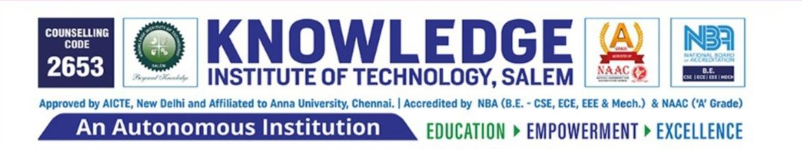
DOMAIN-SALESFORCE DEVELOPER USECASE-EVENT MANAGEMENT SYSTEM
Team Members
PRIYADHARSHINI V (IV -IT) JAYADHARANI A (IV - IT)
JAYASHRI AS(IV - IT)
DHARUNKUMAR S(IV - IT)
GUIDE : AYYAPPAN R AP/IT
MENTOR AYYAPPAN R AP/IT
EVALUATOR : AYYAPPAN R AP/IT

Slide 2
What is Salesforce ?
Salesforce is a popular cloud-based customer relationship management (CRM) platform that helps businesses manage their relationships and interactions with customers and potential customers. It offers a wide range of tools and features for sales, marketing, customer service, and more.
Salesforce allows businesses to store customer data, track leads and opportunities, automate various tasks, and provide a unified view of customer information to improve overall business efficiency and customer satisfaction. It is widely used across various industries to streamline processes and enhance customer engagement.

Slide 3
EVENT MANAGEMANT SYSTEM
An event management system in Salesforce refers to a comprehensive solution built within the Salesforce platform to plan, organize, execute, and analyze events.
It leverages Salesforce's robust CRM capabilities to manage various aspects of events, from initial planning and attendee registration to post-event analysis and follow-up.

Slide 4
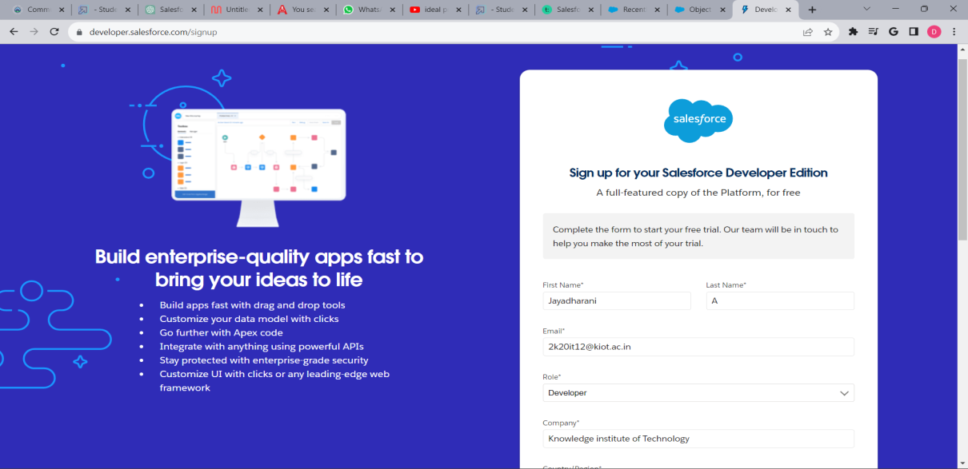
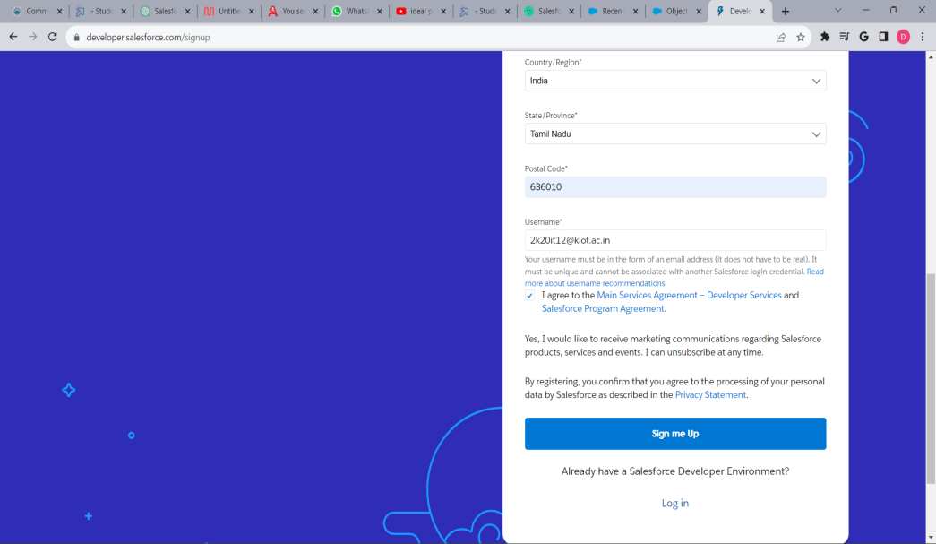
1. Creation of Developer Account
A Developer org has all the features and licenses you need to get started with Salesforce.1.Search developer.salesforce.com/signup

Slide 5
2. Object Creation
What is an Object?
In Salesforce, an object is a data structure representing a table storing specific information, comprising fields and records, crucial for efficient data management and organization.
Two Types
Standard Objects: - Predefined entities like Accounts and Contacts in Salesforce, catering to common business needs without extensive customization.
Custom Objects: - User-defined entities allowing businesses to create tailored data structures, enabling unique data storage and specialized application development.

Slide 6
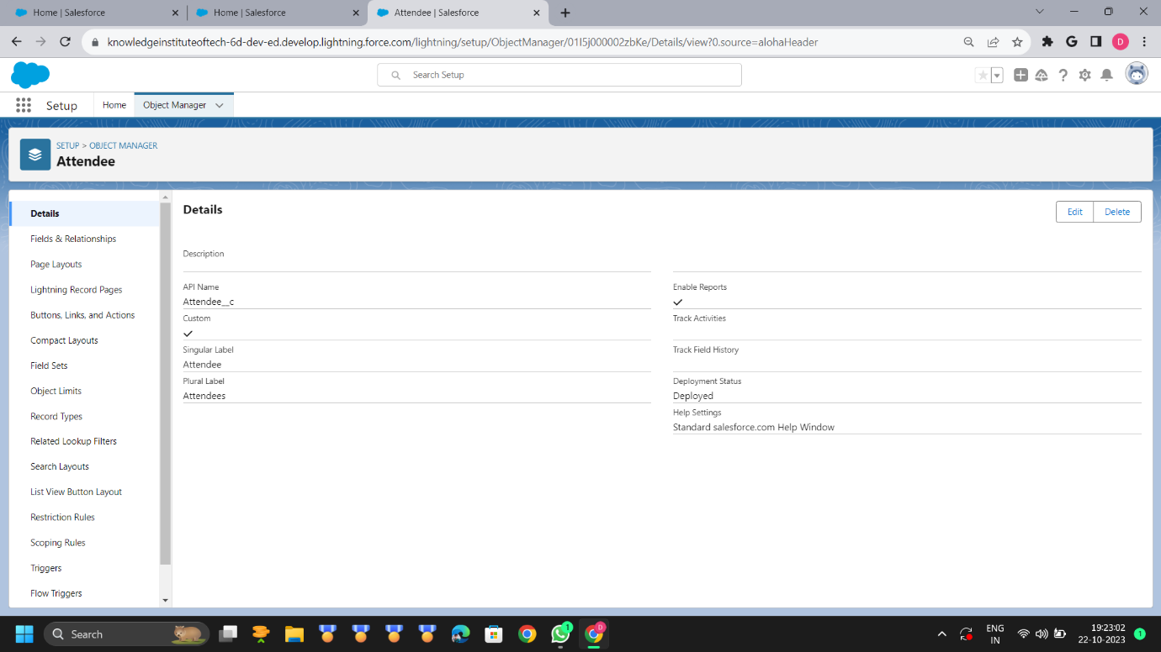
In this Application we use some Objects
Attendees
Speaker
Vendors
Junction

Slide 7
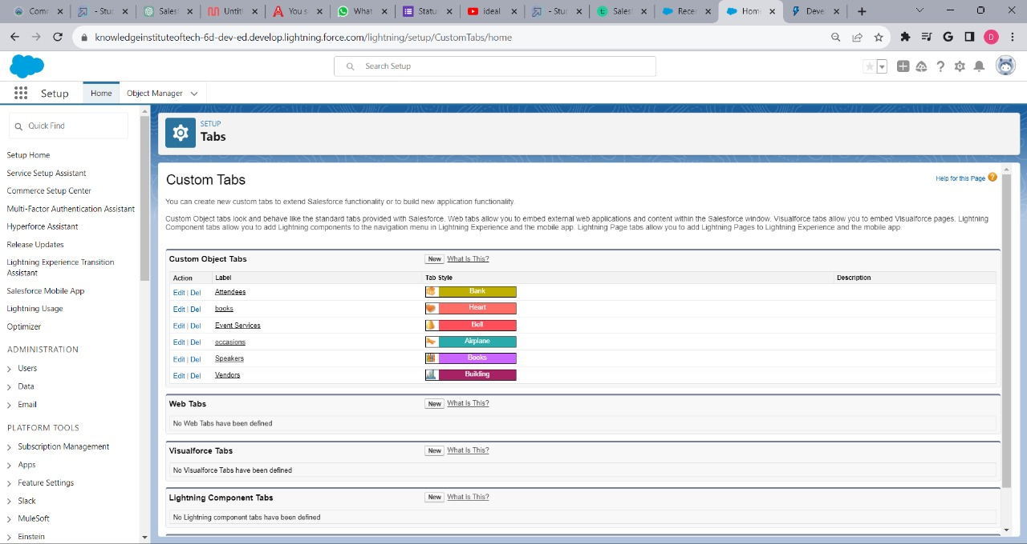
3. Tabs Creation
Tabs in Salesforce are sections for navigation, providing access to data and functions.
Occasion tab
Attendee tab
Speaker tab
Vendor tab
Event Service tab

Slide 8
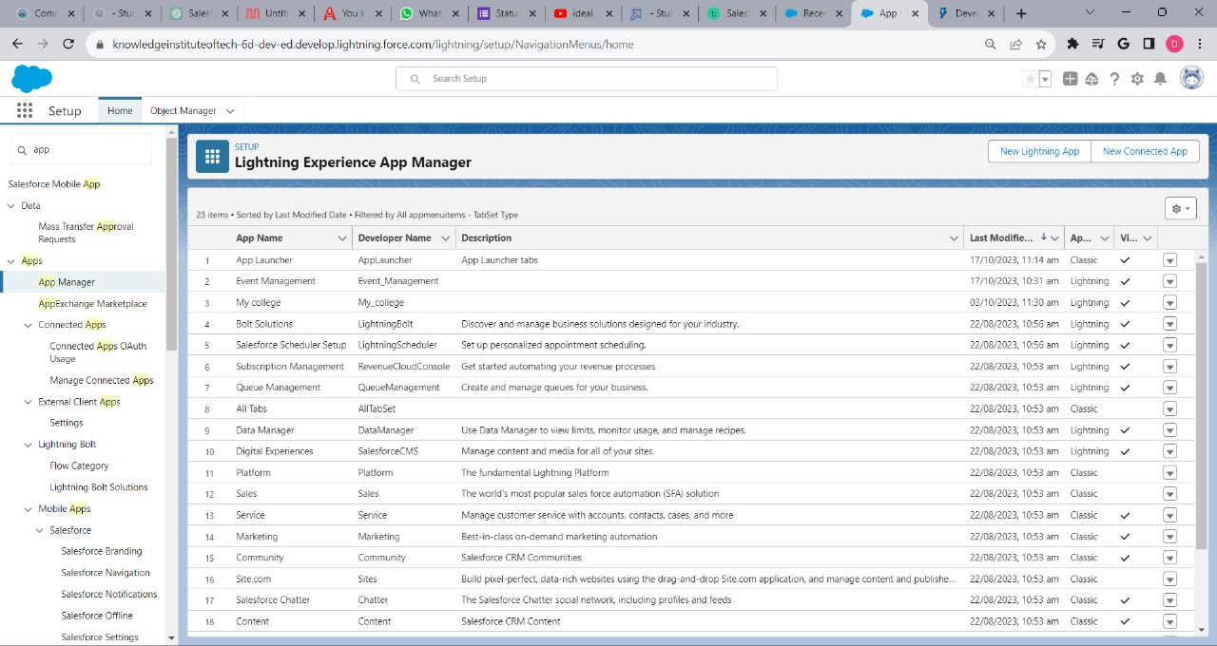
4. Create App
Salesforce offers standard (Sales Cloud), custom, and third-party apps through AppExchange.
These include mobile, community, and integration apps, empowering businesses with versatile solutions for CRM, collaboration, and efficiency.

Slide 9
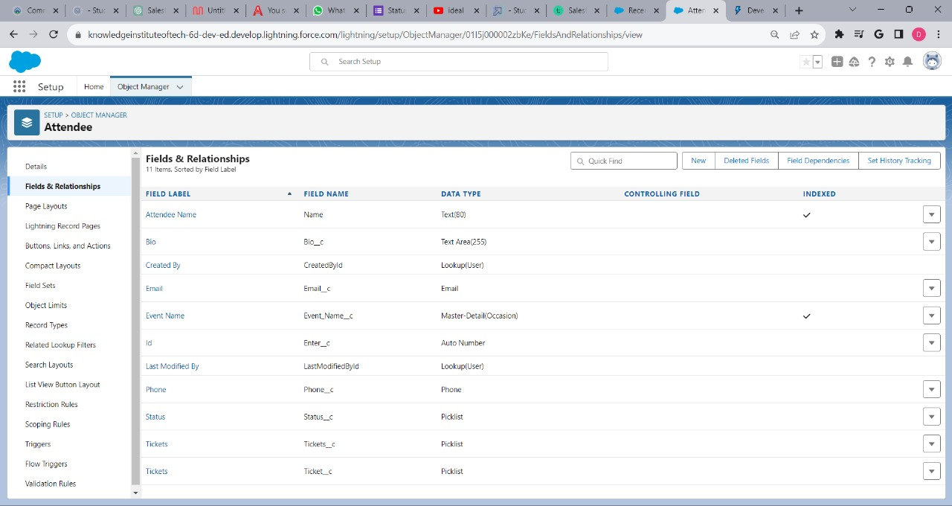
5. Fields & Relationships
When designing an event management system in Salesforce, creating appropriate fields and relationships is crucial for effective data management and reporting

Slide 10
6. Record Types
Record types in Salesforce enable customized user experiences.
They define distinct page layouts, picklist values, and business processes based on user profiles.
By assigning different record types to records, organizations can streamline data entry, ensuring relevant information is captured for various contexts.
This flexibility enhances user efficiency and allows businesses to adapt Salesforce to their specific needs, optimizing workflow and data management across diverse teams and processes.

Slide 11
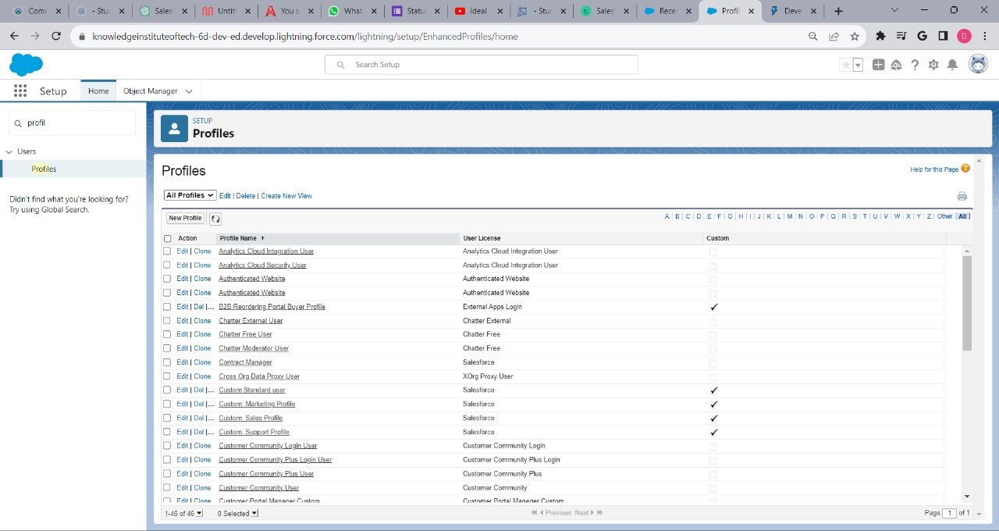
7. Profile
Our Salesforce Event Management System is a robust, scalable, and fully integrated solution designed to streamline the entire lifecycle of events within the Salesforce platform. From planning and organization to execution, analysis, and follow-up, this system is tailored to meet the diverse needs of event organizers and businesses.

Slide 12
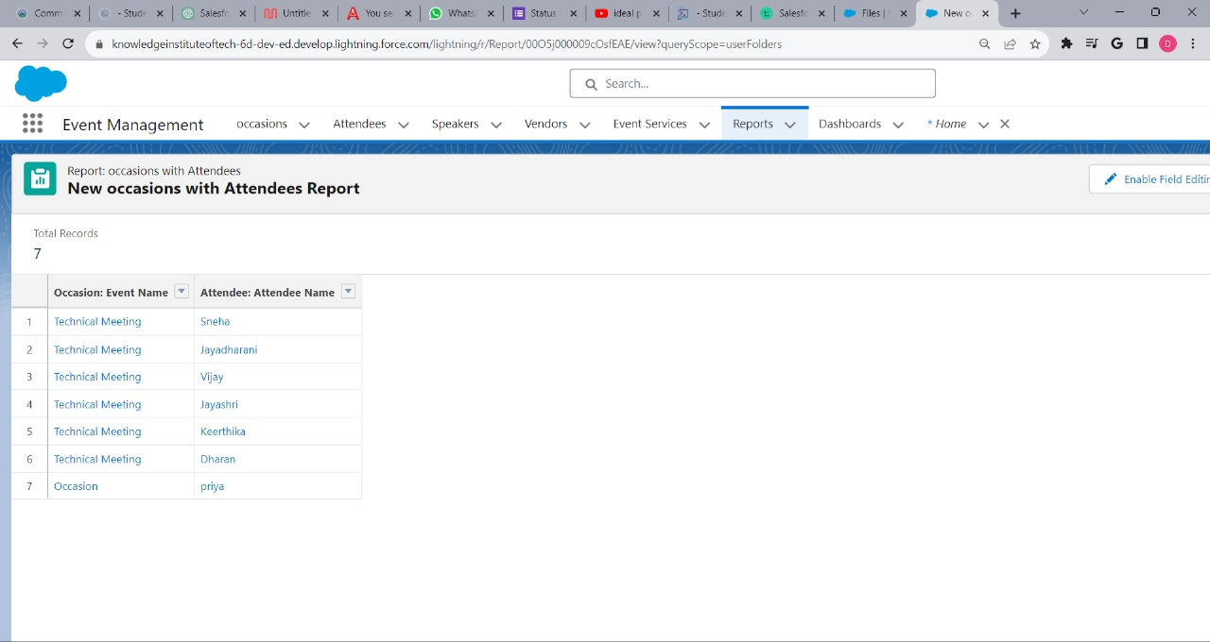
10. Reports
Creating reports in an Event Management System within Salesforce is essential for analyzing event data, measuring success, and making data-driven decisions. Here's an example of a sample report that could be generated in Salesforce for event management:

Slide 13
THANK YOU

